Slide 1
Creating patterns is like mapping the night sky
Susan Spencer
Roman Telezhynskyi
Valentina open source pattern design software
www.valentina-project.org
Notes:
Since begin our history tailors tries to find way to make cloth that will suit human body perfectly. And they made a great progress. Look around and you will find so many different cloth styles. And since we more or less satisfied with our cloth, they are doing well.
So, sound like nothing to do left for our team. But that's not quite true. Computers. And I almost sure one is with you right now. Yes I am talking about your smartphone. Computers allow make our life easier. But what about making cloth? Does computers help us here too? Yes, sure. And this is main reason why we begun this project.

Slide 2
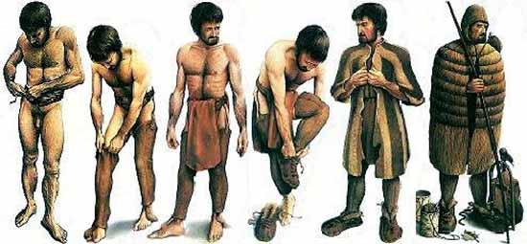
Everybody wears clothes
www.valentina-project.org
Notes:
Cloth is very important part of human culture. Almost 100% of human population wear cloth. :) It can be very complex and very primitive. But what is a good cloth? This is taught question. Human body has complex shape. We all feel good cloth, but not many people understand how to make such cloth.
Otzi - 5,300-year-old body of Otzi the Iceman in Bolzano, Italy wore a woven grass cloak, leather vest and shoes, were quite sophisticated.

Slide 3
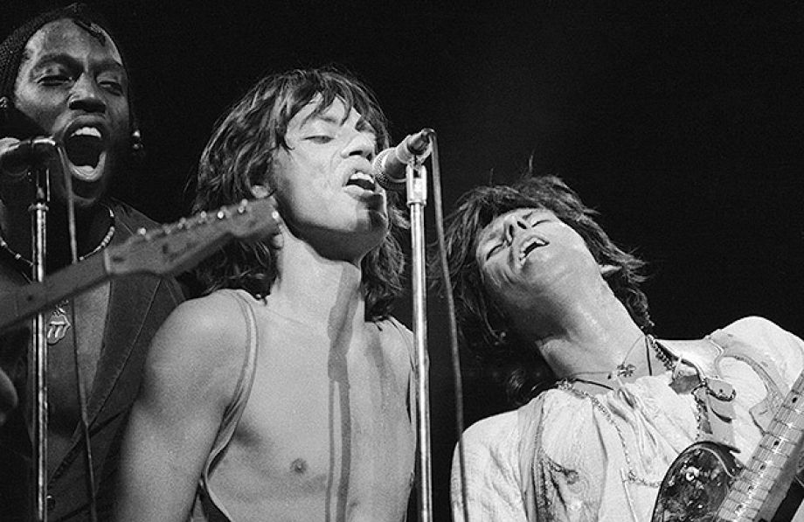
Open Source Fashion
“You can't always
get what you want
But if you try sometime
you just might find
You get what you need”
Keith Richards, Mick Jagger
Published by ABKCO Music, Inc.
www.valentina-project.org
www.valentina-project.org
Notes:
If speak about fashion industry I must admit it is not very friendly. I mean from perspective of IT, fashion industry very conservative. All work only for yourself. Current solutions on the market are very expensive. That's ok for big companies, but left almost nothing for middle or small. Don't forget about hobbyist, they also need a tool for own experiments. Because experiments is only way for making progress.
One thing is also bother us, no one want to support alternative platforms. Almost all solutions support Windows only, several support Mac OSX and none support Linux.
So, if no one wants to make product for such category of users, why we also don't have any, even primitive, open source solution?
We need a tool and can't find something that will suit our purposes. Especially because we are fans of made-to-measure approach. And big companies don't really work like this.
21th August 1976: The Rolling Stones headline the Knebworth Festival. Left to right: percussionist Ollie Brown, singer Mick Jagger and guitarist Keith Richards.

Slide 4
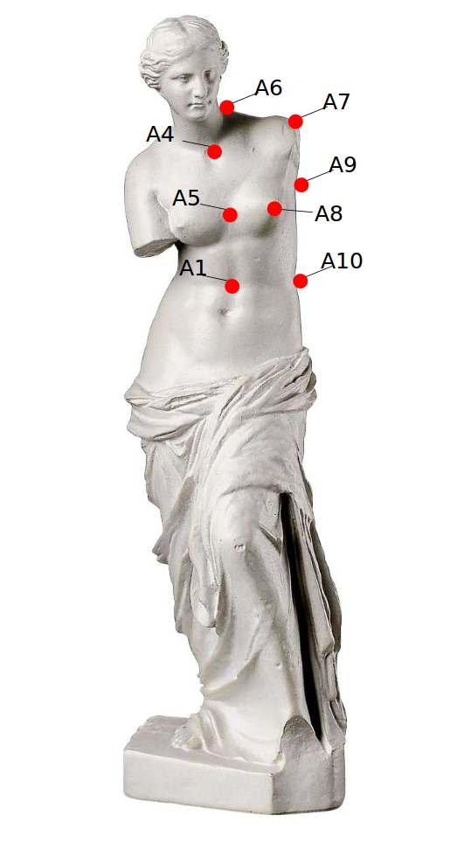
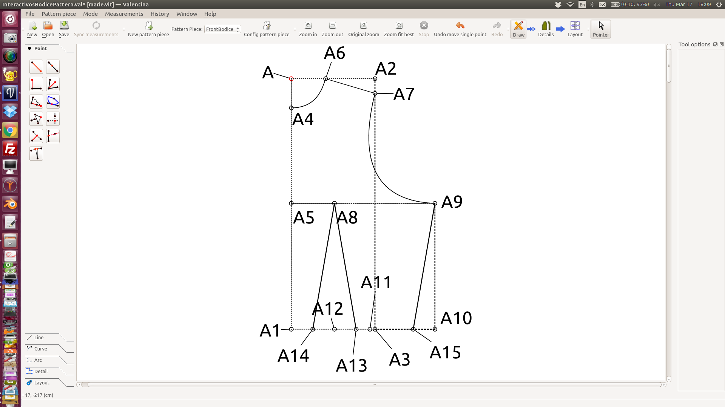
Like stars, the positions of pattern points are calculated from known points
www.valentina-project.org
www.valentina-project.org
Notes:
Human body is very complex shape. And a pattern also very complex image. For example. Imagine a night sky. Do all stars on the same distance from us? No. It is only an illusion. And all known constellation only an illusion. And we are very sure some stars already don't exist, but we still seeing them because light need a time to reach us.
Same true for our patterns. When you use the made-to-measure approach, you start with one base point for each a pattern piece. Then you calculate distance to another point and connect those points, if need, with a segment. You repeat this process as many times as you need. Of course, we are not cubes, we also connect points with curves and arcs.

Slide 5
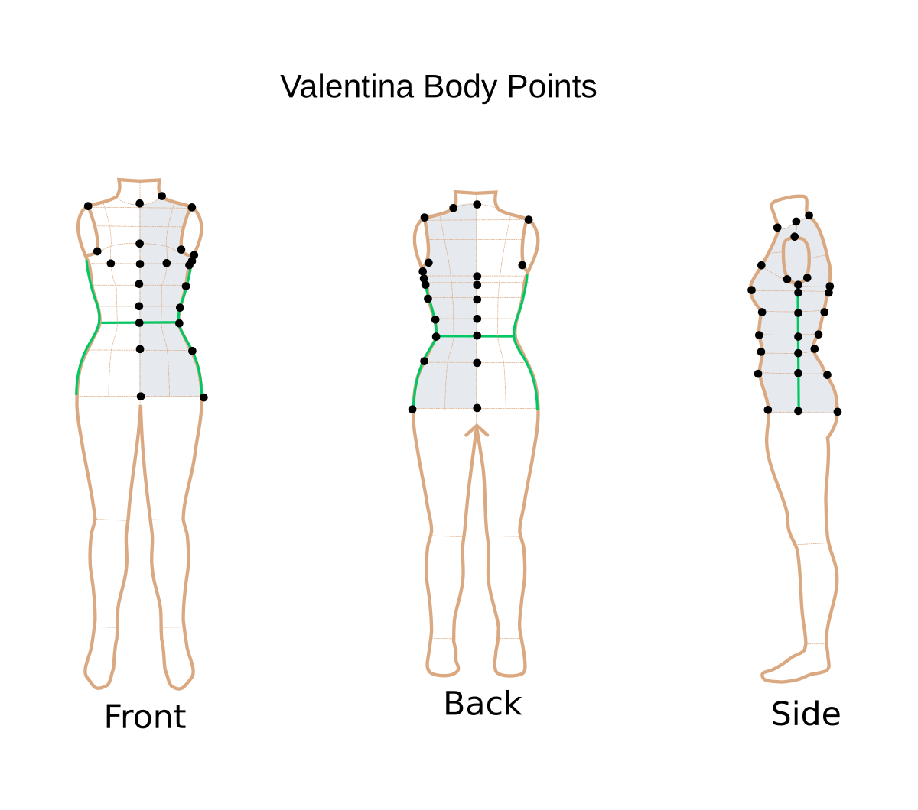
Measurements
www.valentina-project.org
www.valentina-project.org
Notes:
And even this is not the end. We totally have forgot to say about measurements. In short we support two types: individual and standard. And added more than 100 body measurements to our database. This database allow us translate each name relative to language and pattern making system. This will help pattern makers to understand each other even better.

Slide 6
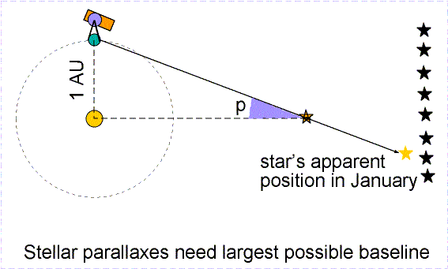
Calculate star positions
http://www.astronomynotes.com/starprop/s2.htm
www.valentina-project.org
www.valentina-project.org
Notes:
How is it related to a night sky, you will ask me? That's simple. Our pattern is also a vector image. On each step of creation, each object knows about all objects that had been created before. So it is like night sky in space and time. Such sequences hard to modify, because of strong connections, but it also allow us to recalculate distances between points. Long time ago tailors found ways to use measurements in formulas for finding perfect distances. And we use this fact.

Slide 7
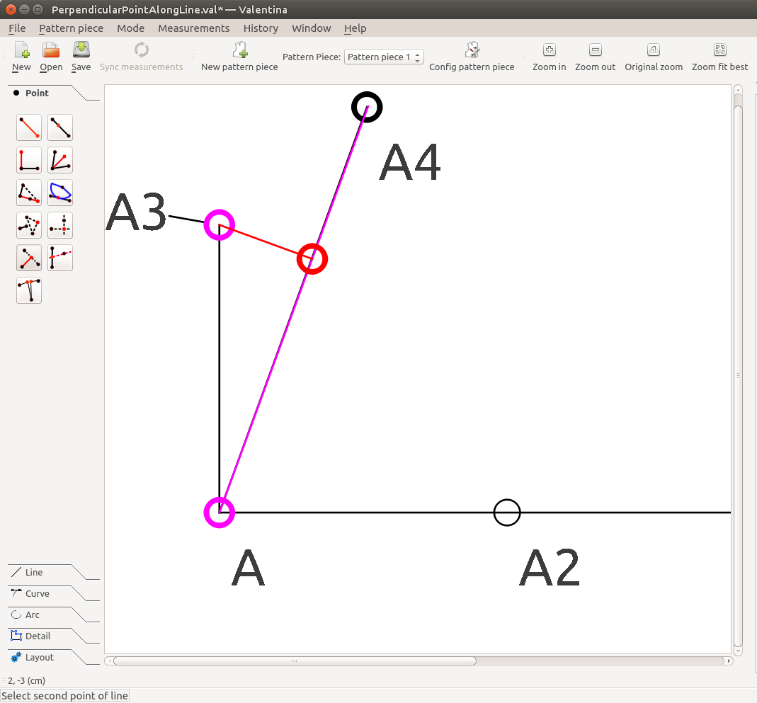
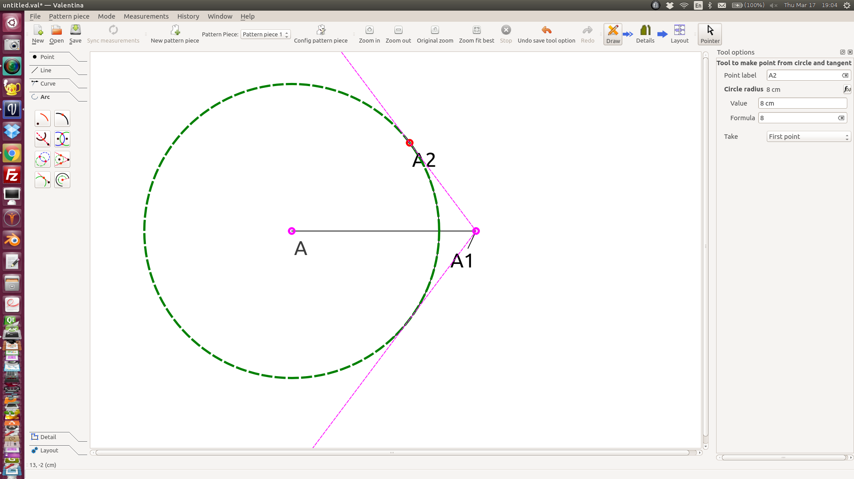
Calculate pattern points
www.valentina-project.org
www.valentina-project.org
Notes:
In fact, when we say a distance between points, we almost always mean a formula, not just single value. And a pattern is not only contain simple segments, but also very big set of different geometry cases: point along line, point along perpendicular, point along bisector and so on. And such cases even more than we have implemented tools now. Do you understand what this mean? We can quick adapt a pattern to your set of measurements. Of course, this is highly depend on pattern maker, because we only make a tool. How to make patterns you must find out yourself. But this is real way to get good suited cloth.

Slide 8
Open Data Formats
There wasn't an open source file to hold formulas
so we created our own file format
<pattern>
<!--Pattern created with Valentina (http://www.valentina-project.org/).-->
<version>0.2.4</version>
<unit>cm</unit>
<author/>
<description/>
<notes/>
<measurements/>
<increments/>
<draw name="Pattern piece 1">
<calculation>
<point type="single" x="0.79375" y="1.05833" id="1" name="A" mx="0.132292" my="0.264583"/>
<point type="endLine" typeLine="hair" id="2" name="A1" basePoint="1" mx="0.132292" lineColor="black" my="0.264583" angle="0" length="10"/>
<point type="alongLine" typeLine="none" id="3" name="A2" firstPoint="1" secondPoint="2" mx="0.132292" lineColor="black" my="0.264583" length="Line_A_A1/3"/>
<point type="normal" typeLine="hair" id="4" name="A3" firstPoint="1" secondPoint="2" mx="-1.3253" lineColor="black" my="-0.525679" angle="0" length="Line_A2_A1/2"/>
<point type="endLine" typeLine="hair" id="5" name="A4" basePoint="1" mx="0.132292" lineColor="black" my="0.264583" angle="70" length="5"/>
<point type="height" typeLine="hair" id="6" name="A5" basePoint="4" p2Line="5" mx="0.132292" lineColor="black" my="0.264583" p1Line="1"/>
</calculation>
<modeling/>
<details/>
</draw>
</pattern>
www.valentina-project.org
www.valentina-project.org
Notes:
Because of such a special way of creating an pattern vector image, none of exist open image formats don't suite our purposes. This fact forced us to creating our own format for a pattern and measurements. Unfortunately this make our solution standalone, no one will support our format for now.

Slide 9
Valentina Method
Step 1: Design (Draw mode)
www.valentina-project.org
www.valentina-project.org
Notes:
Let's speak about our typical workflow: design, detail, layout. This is thing that give us many trouble. This approach is different than regular vector editors workflow. With regular vector editor you do all your work on the same screen. Our first screen is only a draw. Before you will go to the second stage, details, you will need to make at least one detail. And that's why many users do not expect such a way.

Slide 10
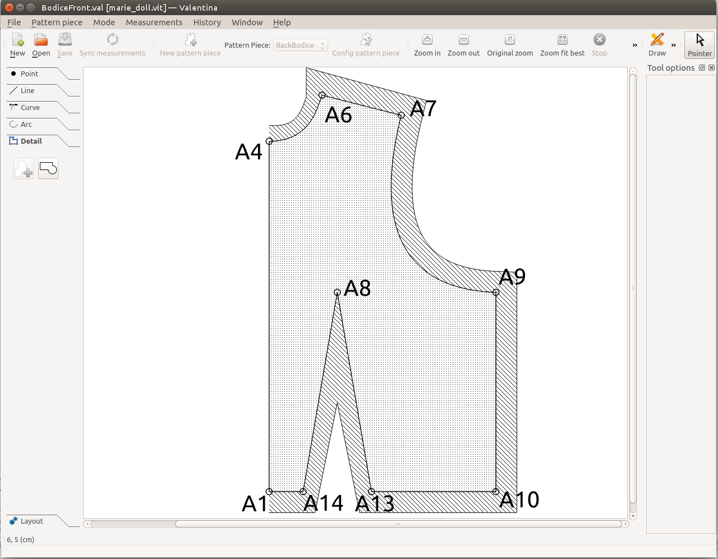
Valentina Method
Step 2: Detail mode
www.valentina-project.org
www.valentina-project.org
Notes:
Why details? Because pattern even more complex than you think. Do your cloth has one layer? Most time two or more. So just highlight a path will not help you, like thing some people.
Simplest detail contains only a path. A path is a set of points, arcs, curves in clockwise direction. But most time we also need seam allowance, notches, grain line, pass marks, some description text. Details is exactly what you expect to see on paper.

Slide 11
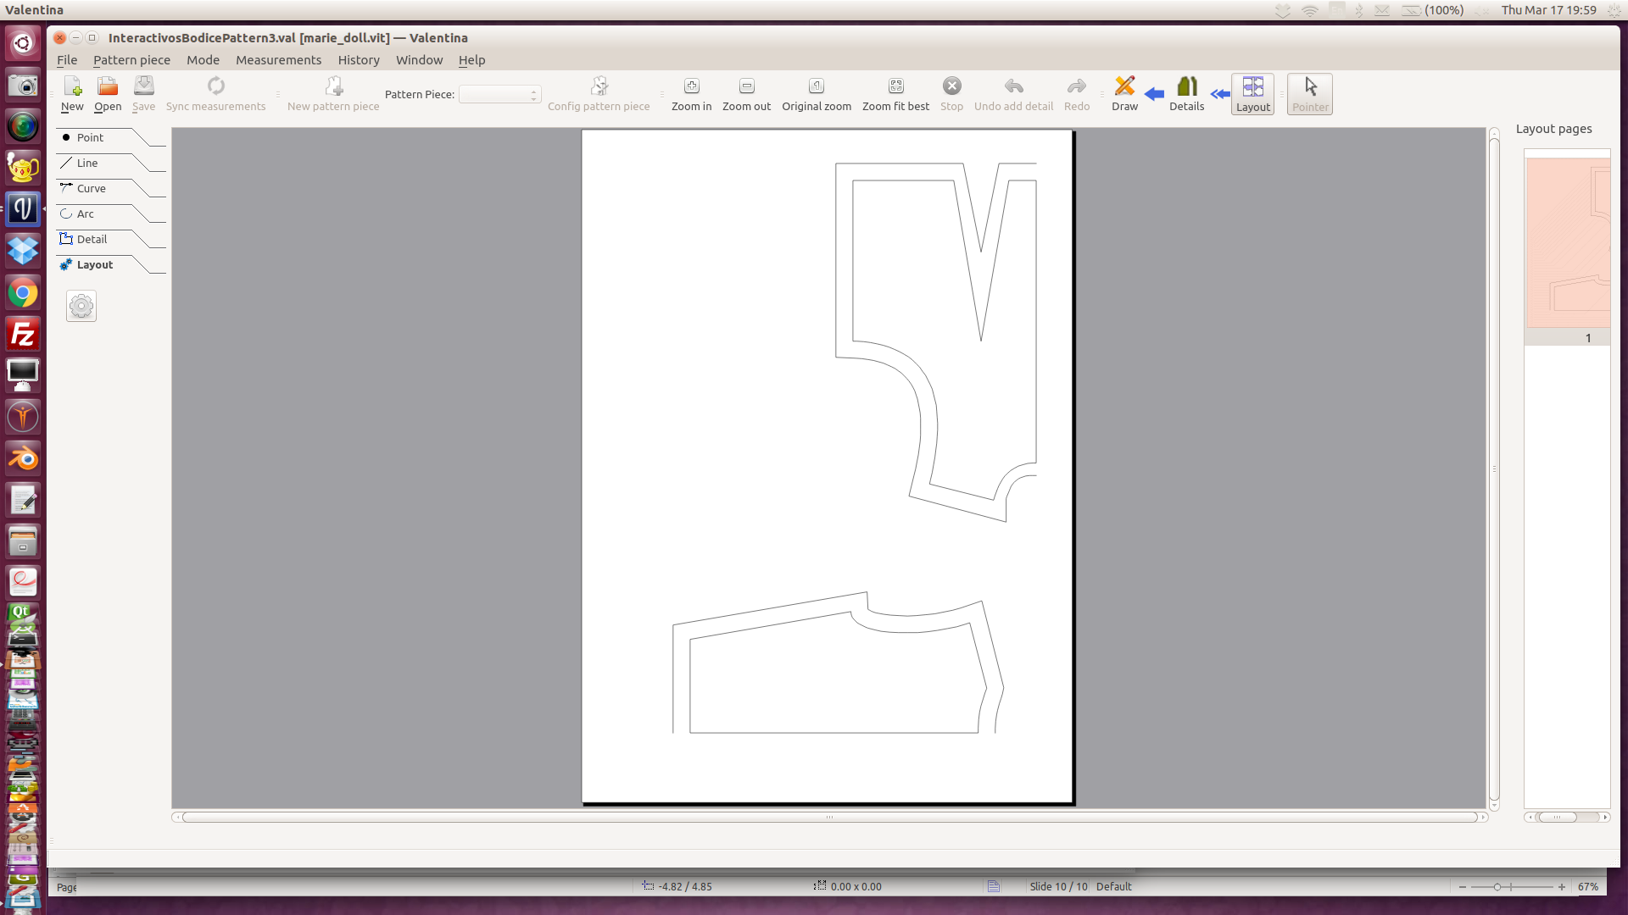
Valentina Method
Step 3: Layout mode
www.valentina-project.org
www.valentina-project.org
Notes:
And the last, but not the least, a layout. Also thing that is very specific for cutting processes. Because here we are touching the real world, all want spend less expensive fabric as possible. For such purpose we have been developing special algorithm that seek best position for each detail onto paper sheet.
After you get a layout you have two options: print it or export to common image format. Currently we support svg, png, eps, ps, dxf.

Slide 12
Future Development
3D Development Sprint
Libre Graphics Meeting 2016
MakeHuman
MeshLabjs
Blender
Valentina
End-to-end design for real and digital clothes to fit you and your characters
www.valentina-project.org
www.valentina-project.org

Slide 13
Join Our Team
Community Leader
C++ Developers for 2D and 3D
Wiki Admin
Translators
- Chinese
- Arabic
www.valentina-project.org
www.valentina-project.org

Slide 14
Join the Revolution
contact@valentina-project.org
www.valentina-project.org
bitbucket.org/dismine/valentina
@ValentinaPSW
https://www.facebook.com/Valentina.Project

